Slide 1

CS302 Design and Analysis of Algorithms
Muhammad sohail afzal

Slide 2
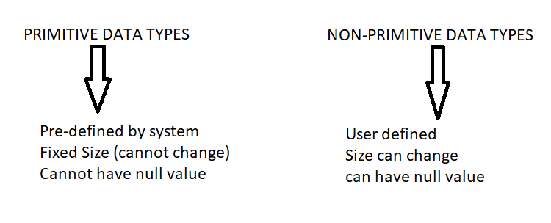
Quick Review of Data Structures

Slide 3
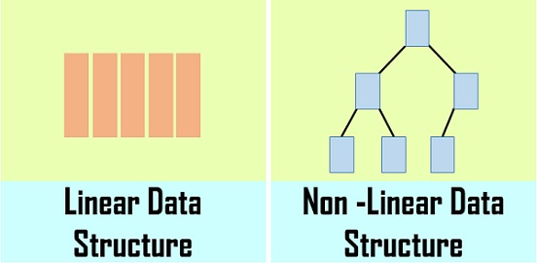
Quick Review of Data Structures

Slide 4
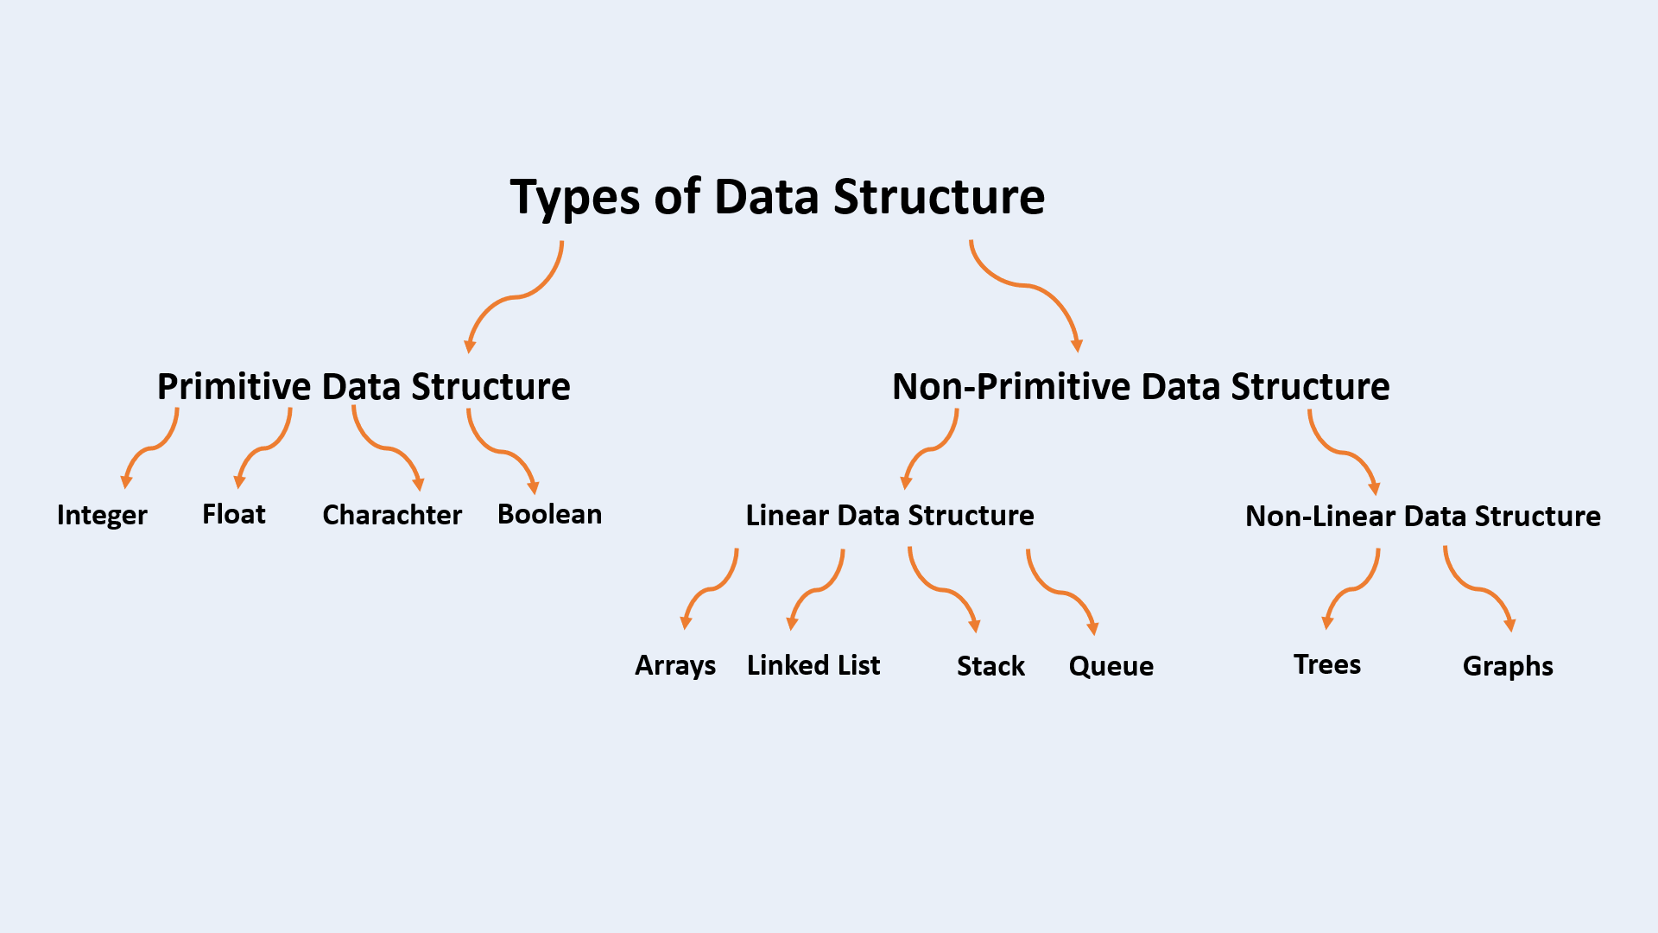
Quick Review of Data Structures

Slide 5
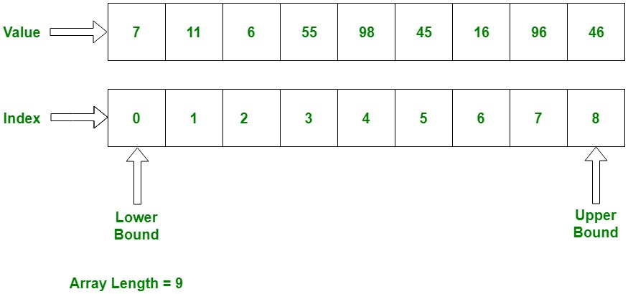
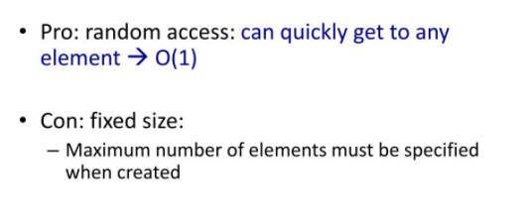
Arrays - (Linear Data Structure)

Slide 6
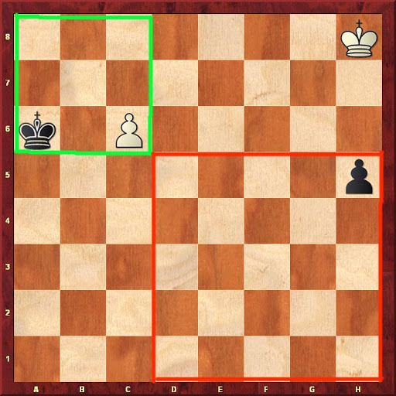
Arrays – Applications

Slide 7
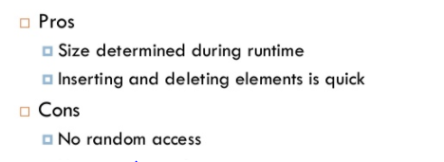
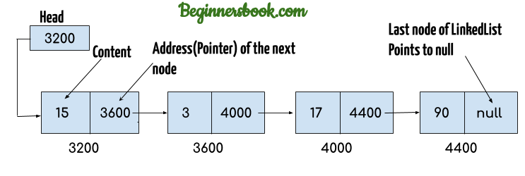
Linked List - (Linear Data Structure)

Slide 8
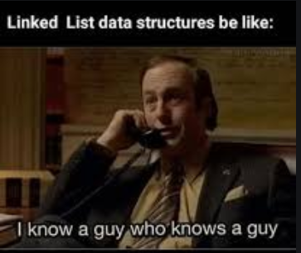
Linked List - (Linear Data Structure)

Slide 9
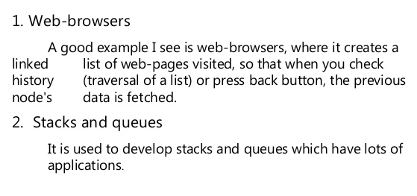
Linked List – Applications
3. To implement graphs as well

Slide 10
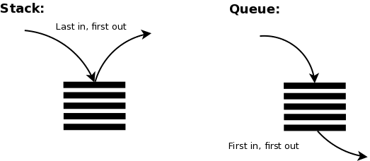
Stacks & Queues– (Linear Data Structure)

Slide 11
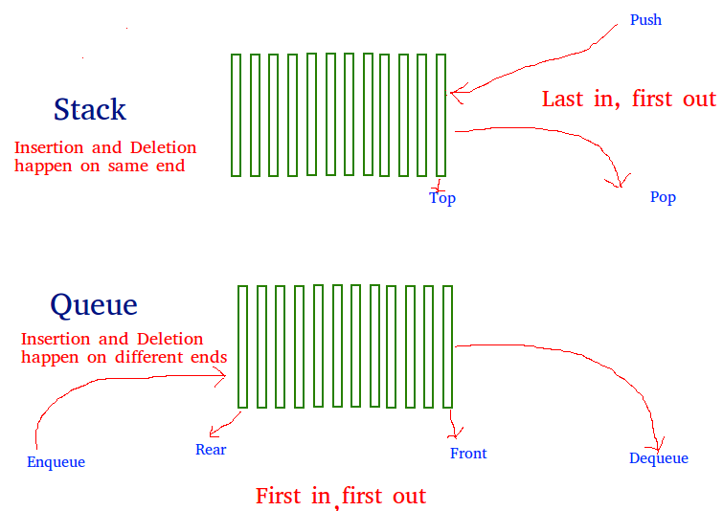
Stacks & Queues– (Linear Data Structure)

Slide 12
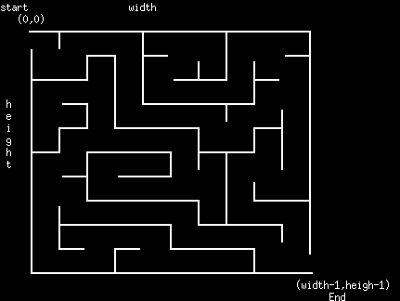
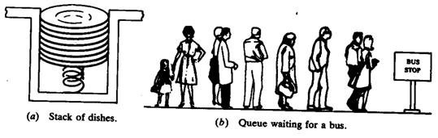
Stacks & Queues – Applications

Slide 13
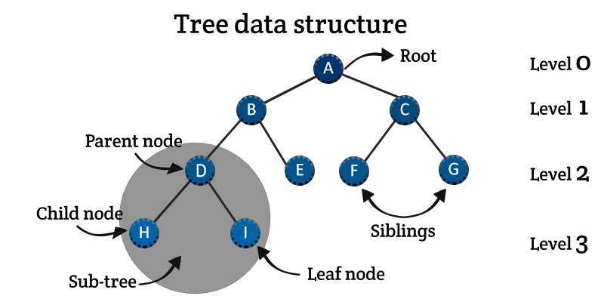
Tree – (Non-Linear Data Structure)

Slide 14
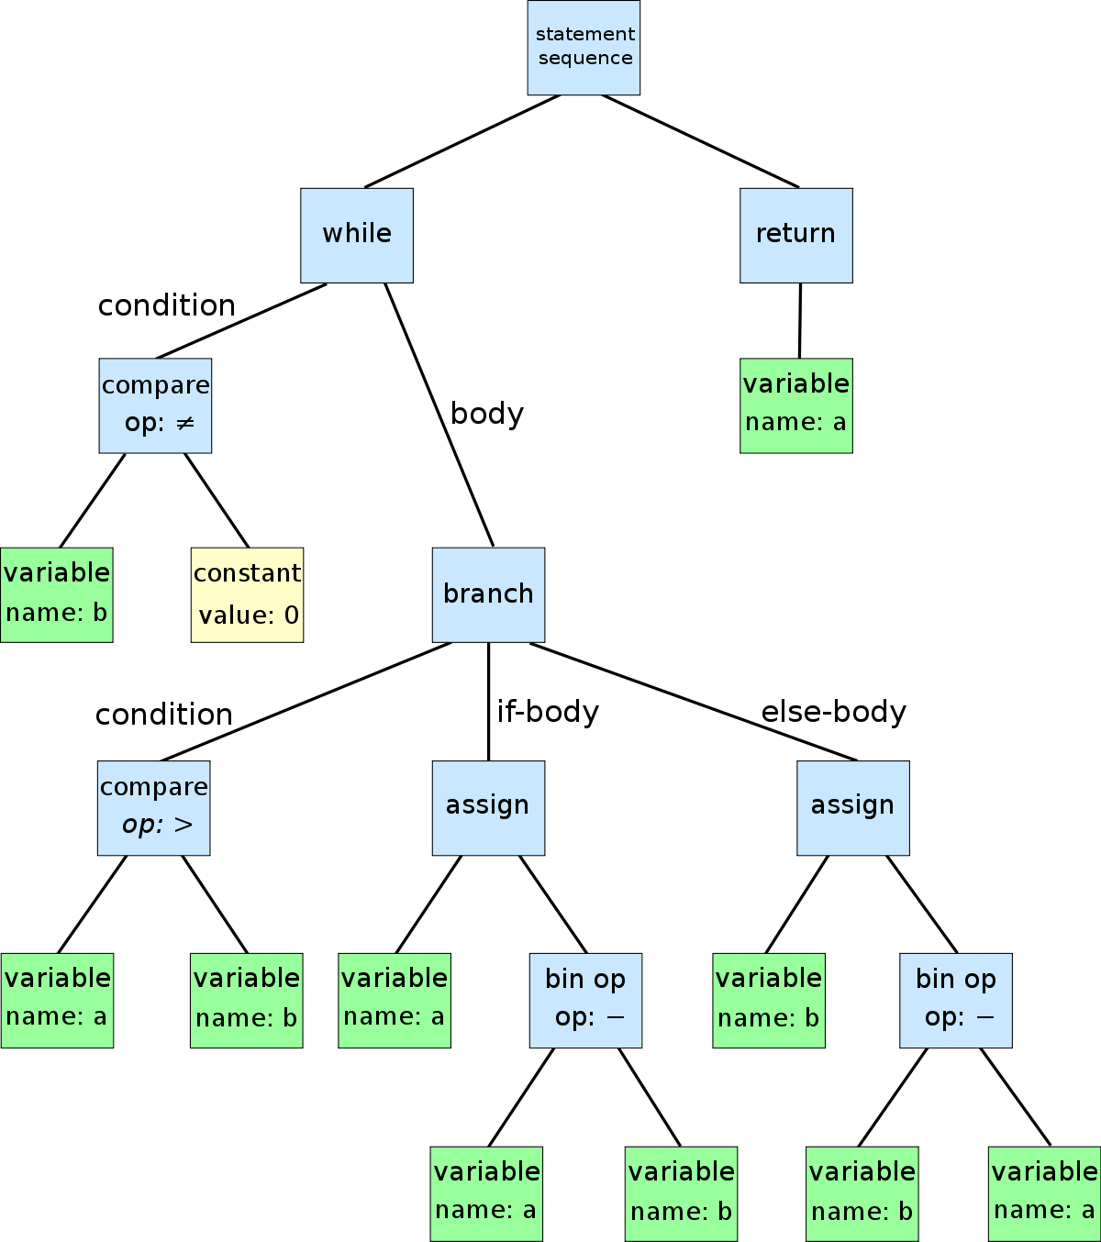
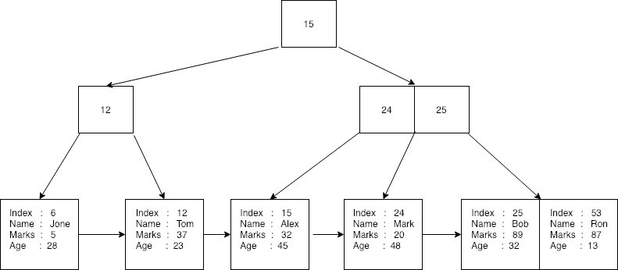
Tree – Applications
Abstract Syntax Trees Database Indexing

Slide 15

Graphs – (Non-Linear Data Structure)

Slide 16
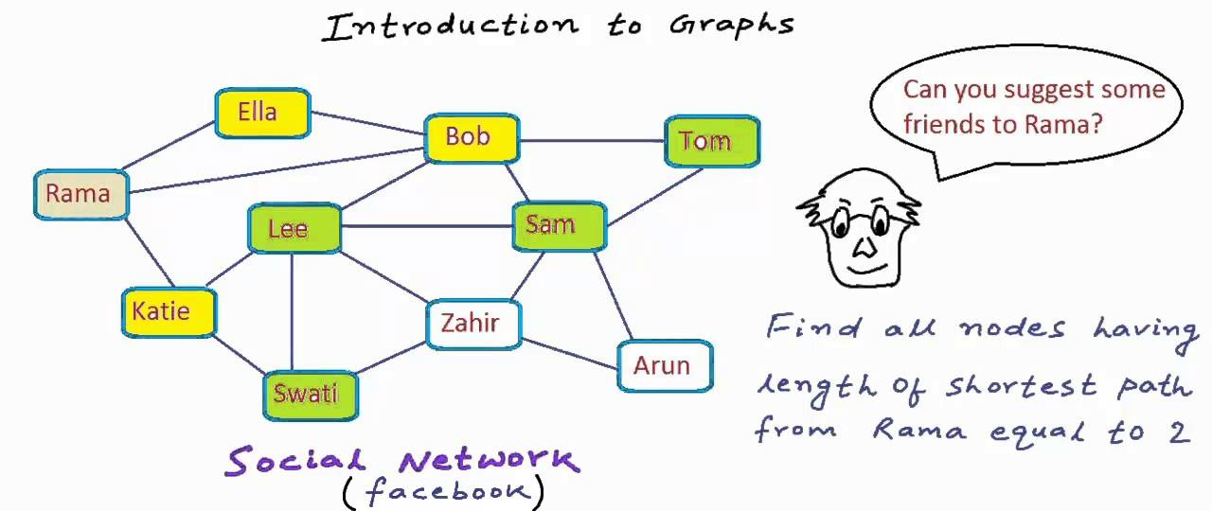
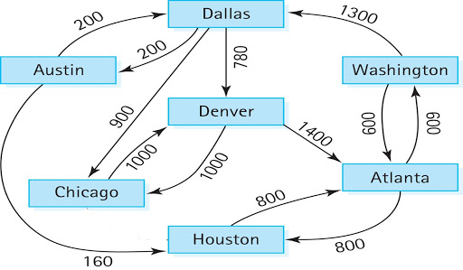
Graphs – Applications

